Slide 1
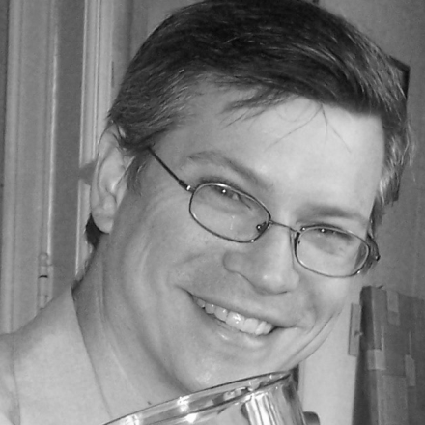
Programatically working with ColdFusion & PDF
6/9/2011
Central Georgia ColdFusion Users Group
Presenter: Tim Cunningham
Email: timcunningham71@gmail.com
Twitter: timcunningham71
Blog: CFMumboJumbo.com

